Slide 1
CHO metabolism (GLYCOGEN Metabolism)
By
Shuzan Ali Mohammed Ali
Assist. Prof. of Medical Biochemistry
&
Molecular Biology

Slide 2
GLYCOGEN METABOLISM
Glycogen is the major storage form of carbohydrates in animal cells.
Its metabolism involves two processes.
I- Glycogenesis: (Glycogen formation).
II- Glycogenolysis: (Glycogen breakdown).

Slide 3
GLYCOGENESIS
Definition:
It is the formation of glycogen from or
(Glucose or other hexoses → Glycogen)
Site:
It occurs in the cytosol of cells (except RBCs) specially in liver & muscles.
Importance:
Storage of excess glucose, or other hexoses taken in food.
Glucose
Other hexoses

Slide 4
hexokinase
UDPG acts as a substrate for glycogen synthesis.

Slide 5
Glycogen synthase (the key enzyme):
It transfer glucose from UDPG to a glycogen primer forming α 1,4-glucosidic bonds between C1 of activated glucose of UDP-G & C4 of a terminal glucose residue of glycogen, liberating UDP.
Glycogen synthase function is to elongate short branches in the glycogen tree up to 12 glucose units.

Slide 6
A preexisting glycogen molecule or glycogen primer must be present to initiate this reaction.
Glycogen may in turn be formed on a primer known as glycogenin (37-kDa protein, glycosylated on a specific tyrosine residue by UDP-G).
Further glucose residues are attached in the 1→4 position to make a short chain that is a substrate for glycogen synthase.

Slide 7
II. The branching enzyme:
It transfers some glucose units from the end of a long branch to one of glucose units in the middle of an adjacent long branch forming α 1,6-glucosidic bond.
A new branch appears on which glycogen synthase can act again.

Slide 8
Biosynthesis of glycogen (Glycogenesis)
Glycogen primer

Slide 9
Regulation of glycogenesis:
Glycogen synthase is the key enzyme.
Covalent modification:
Glycogen synthase is present in 2 forms:
Glycogen synthase a (active dephosphorylated)
Glycogen synthase b (inactive phosphorylated)

Slide 10
Hormonal regulation of glycogenesis

Slide 11
Induction & repression of the key enzyme:
CHO feeding induce insulin synthesis of Glycogen synthase, glycogenesis is stimulated.
Fasting decreases insulin & increases anti-insulin → decrease synthesis of Glycogen synthase & glycogenesis is inhibited.

Slide 12
Allosteric Regulation:
Glycogen synthase is allosterically activated by G-6-P and allosterically inhibited by glycogen.
CHO feeding increase insulin so increase glycogenesis.
Fasting decrease insulin and increase anti- insulin and inhibit glycogenesis.

Slide 13
117

Slide 14
GLYCOGENOLYSIS
Definition:
It is the breakdown of glycogen into glucose or glucose 6-phosphate
Site:
It occurs in the cytosol of cells (except RBCs) specially in liver & muscles.
Importance:
In liver: supplies blood glucose during fasting less than 18 hours.
In muscles: source of energy during exercise.

Slide 15
Steps:
The key enzyme (Glycogen phosphorylase) catalyzes removal of glucose residues from outermost chains in the form of G-1-P until 4 glucose units on either side of α-1,6 branching point.
Then 1 , 4 - glucan transferase transfers a trisaccharide unit from one side to the other.
Debranching enzyme catalyzes hydrolytic splitting of α-1, 6 bond; phosphorylase can act again.

Slide 16
Glycogen Phosphorylase is the key enzyme.

Slide 17
G-6-Phosphatase:
It is present in liver, kidneys & intestines.
It is not present in muscles.
Liver glycogen can give glucose to blood, but Muscle glycogen cannot give glucose to blood directly (may give it through Cori’s cycle & Glucose-alanine cycle).
.

Slide 18
Regulation of glycogenolysis:
Glycogen phosphorylase is the key enzyme.
Covalent modification:
Glycogen phosphorylase is present in 2 forms:
Glycogen phosphorylase a (active phosphorylated)
Glycogen phosphorylase b (inactive dephosphorylated)
Inactive phosphorylase (b) is converted to active phosphorylase (a) by phosphorylase (a) kinase, with ATP as phosphate donor.
Inactive Phosphorylase (b) kinase is activated to phosphorylase (a) kinase by cAMP dependent protein kinase A requires cAMP for its activity.

Slide 19
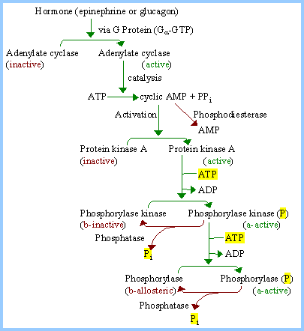

Slide 20
Induction & repression of the key enzyme:
CHO feeding induce insulin → decrease synthesis of glycogen phosphorylase so glycogenolysis is inhibited.
Fasting decreases insulin & increase anti-insulin → increase synthesis of glycogen phosphorylase so glycogenolysis is stimulated.

Slide 21
Allosteric Regulation:
Muscle phosphorylase is allosterically activated by AMP which is increased during muscular exercise.
CHO feeding increase insulin leading to inhibition of glycogenolysis.
Fasting decrease insulin & increase anti- insulin → stimulation of glycogenolysis.

Slide 22
The lactic acid (Cori’s) cycle: In contracting muscle;
Glycogen gives G-6-P which by glycolysis gives
lactate as there is no O₂.
Lactate diffuses to blood and goes to the liver,
where lactate is converted to
glucose by gluconeogenesis.
Glucose can return back to muscles

Slide 23
Glucose-alanine cycle:
If pyruvic acid in muscle is changes to alanine by transamination, it goes to blood then to liver where alanine is changed again to pyruvic by transamination.
By gluconeogenesis, alanine gives glucose which diffuses from liver to blood to contracting muscle again to supply energy.

Slide 24
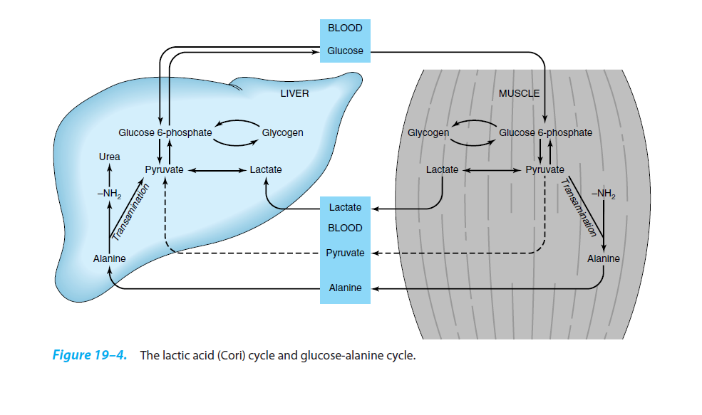
The lactic acid (Cori) cycle and glucose-alanine cycle

Slide 25
Difference between liver glycogen and muscle glycogen
Points | Liver Glycogen | Muscle Glycogen
Amount | 5% =100 gm (liver ~ 2 KG) | 1% =300 gm (muscles~ 30 Kg)
Source | Dietary hexoses by glycogenesis Gluconeogenesis | Blood glucose by glycogenesis
Function | - Source of blood glucose (G-6-Ptase) -Source of energy to liver | - Source of energy to muscle does NOT give blood glucose except through Cori’s or glucose-alanine cycle
Feeding Status | -Increased by diet -Reduced by fasting | - Little effect by diet - Not reduced by fasting .
By Exercise | - Not reduced | - Markedly reduced
Glycogen Phosphorylase | - Monomer - No PLP (no vit B6) - Not affected by AMP | - Dimer (each monomer contains 1 mol. of PLP) - Allosterically + by AMP
Insulin | Increase | Increase
Glucagon* | Decrease | No effect
Adrenaline | Decrease | Decrease
Thyroxin | Decrease | Decrease

Slide 26
GLYCOGEN STORAGE DISEASE ( GLYCOGENEOSIS)
Definition:
Inborn errors of glycogen metabolism caused by deficiency of one of enzymes of glycogenesis or glycogenolysis in different tissues.
Characterized by deposition of:
abnormal type or
abnormal quantity of glycogen
in tissues mainly in the liver and muscle.

Slide 27
Glycogenosis |  | Disease | Deficient Enzyme & Manifestations
Type I | Von Gierke’s disease |  | Glucose-6-phosphatase, enlarged liver & kidney. ↑uric acid, lactic acid, cholesterol, lipid & ketone bodies, Fasting hypoglycemia
Type II | Pompe’s disease |  | Lysosomal glucosidase enzyme in all organs. Fatal in early life.
Type III | Limit dextrinosis or Cori disease |  | Debranching enzyme in liver and muscle. Glycogen has short branches
Type IV | Amylopectinosis (Andersen disease) |  | Branching enzyme in liver. Glycogen has few long branches like amylopectin.
Type V | Mc Ardle’s syndrome |  | Muscle phosphorylase. Muscles become weak after a short exercise (little or no lactate in bl. after exercise)
Type VI | Her’s disease |  | Liver phosphorylase (enlarged liver by ↑glycogen)
Type VII | Tarui’s disease |  | Phosphofructokinase in muscle and RBCs. (as type V plus hemolytic anemia)
Type VIII |  |  | Liver phosphorylase kinase
Type IX |  |  | Liver and muscle phosphorylase kinase
Type X |  |  | cAMP-dependent protein kinase A

Slide 28
Type I glycogenosis (Von Gierke’s disease)
Cause: deficiency of G-6-phosphatase in liver & kidneys → accumulation of large amounts of glycogen in liver & kidneys.
Manifestations:
1- Enlargement of liver and kidney (glycogen accumulation)
2- Fasting hypoglycemia: liver G-6-P cannot leave the liver.
3-Hyperlipemia & hypercholesterolemia: lipids is the metabolic fuel. There is increased lipolysis (increased FFA in plasma) → increased ketogenesis → metabolic acidosis.
4- Hyperuricemia (gout): due to increased HMP shunt → increased ribose-5-P → stimulation of de novo synthesis of purines → increased uric acid formation
5- Lactic acidemia: the liver cannot form glucose from lactate (no Cori’s cycle) which leads to acidosis.

